Slide 1


Image Caption
在医疗影像中的应用
汇报人：王秋里

Slide 2
01
Image Caption
目录
02
Image Caption在医疗影像中的应用

Slide 3
Image Caption

Slide 4
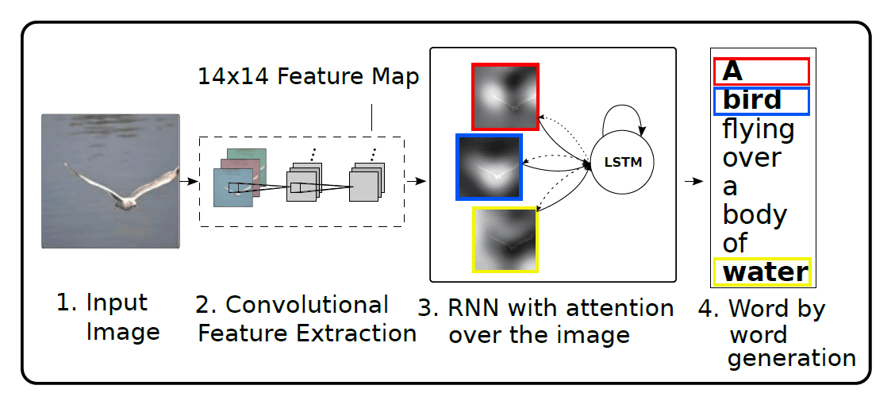
Watch, Attend and Tell (2015 ICML)
Image Caption
Neural Image Caption Generation with Visual Attention

Slide 5
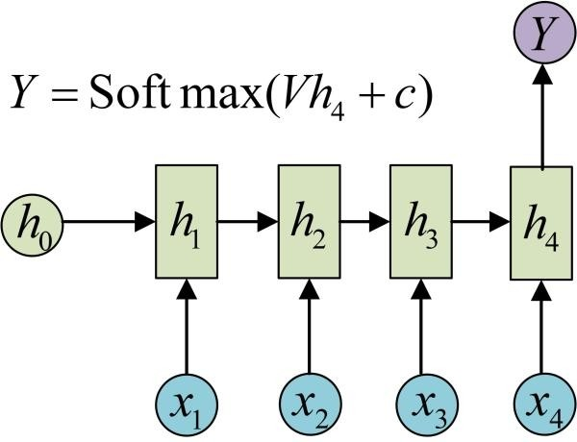
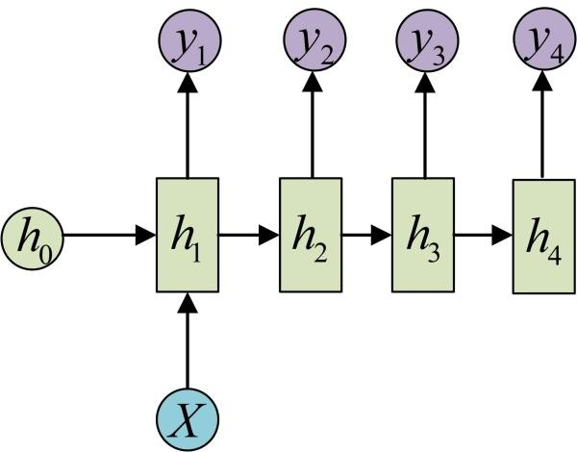
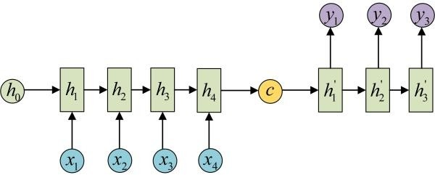
Watch, Attend and Tell
Encoder-Decoder

Slide 6
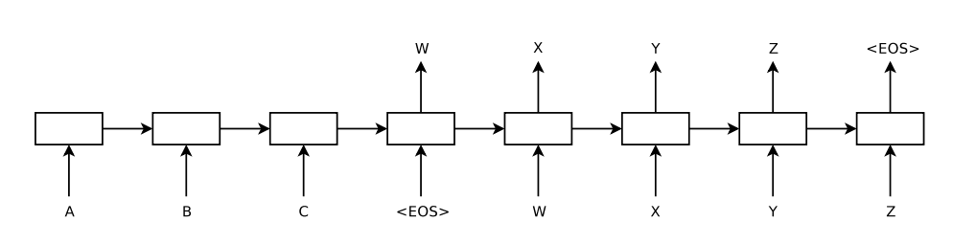
Watch, Attend and Tell
Attention
缺点：无论之前的context有多长，包含多少信息，都会被压
缩成一个几百维的vector。context越大，丢失的信息越多。

Slide 7
Watch, Attend and Tell
Attention
在大部分的论文中，Attention是一个权重vector（通常是softmax的输出），其维度等于context的长度。越大的权重代表对应位置的context越重要。不同论文对attention权重的计算方式不同，但其核心抛不开上述两点。

Slide 8
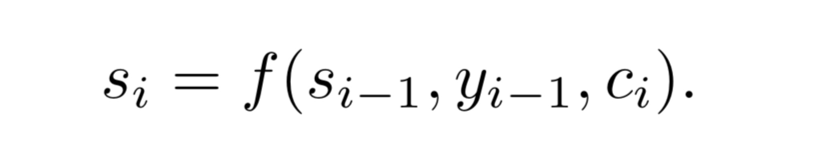
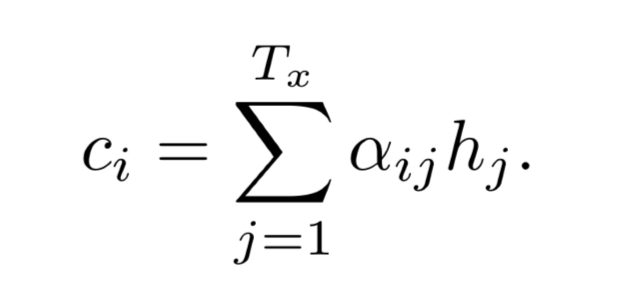
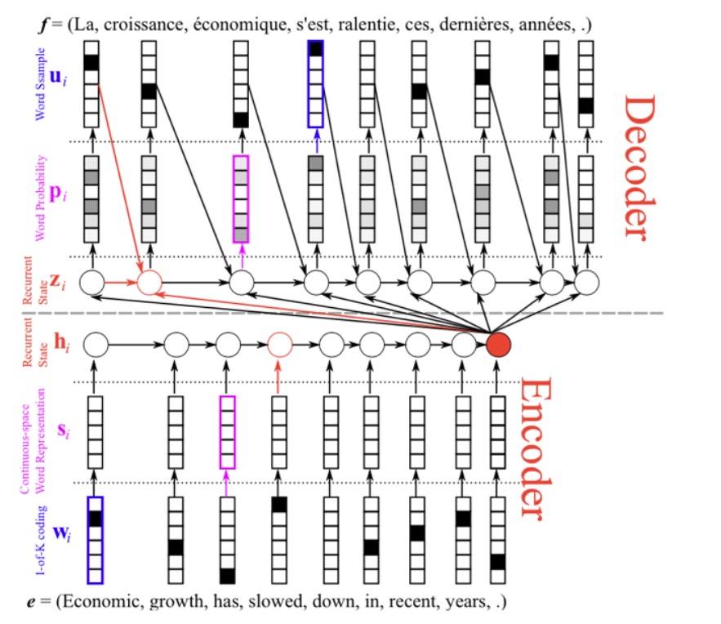
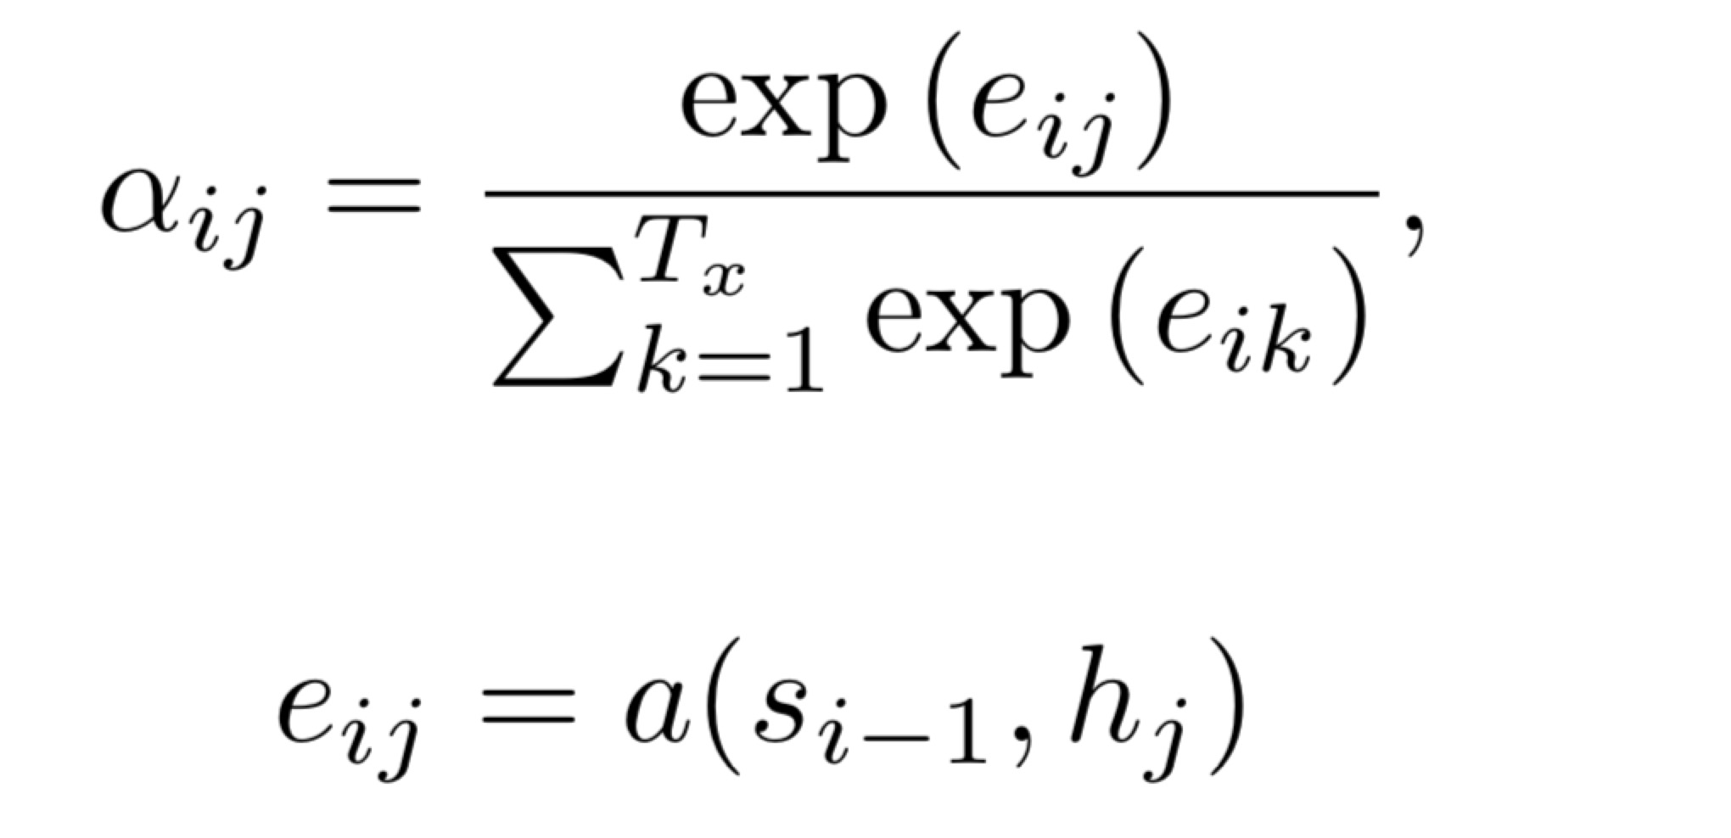
Watch, Attend and Tell
Attention

Slide 9
Image Caption
Image Caption

Slide 10

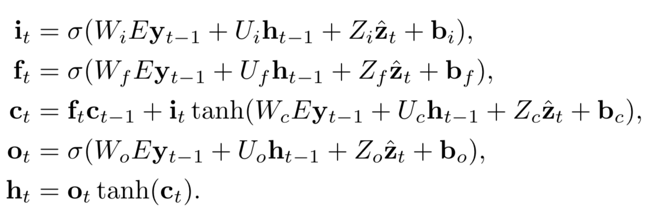
Image Caption
Image Caption

Slide 11
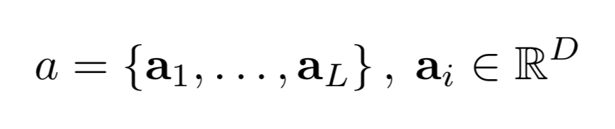
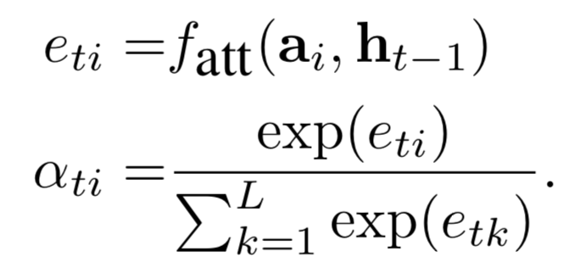
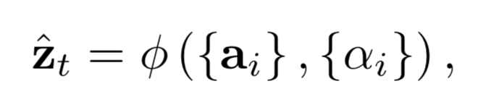
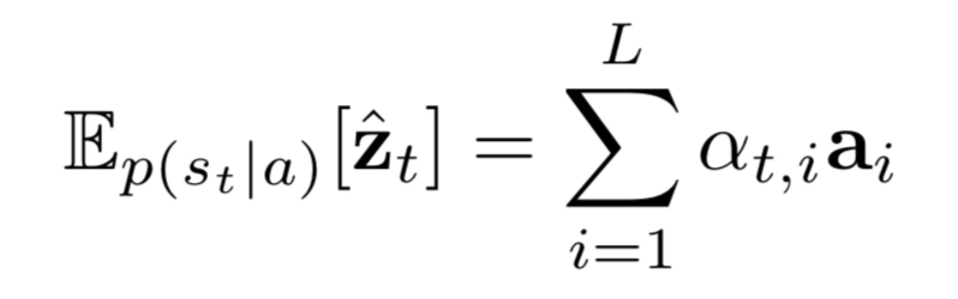
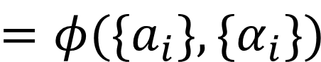
Image Caption
Image Caption
Soft Attention
$$=φ(\{a_{i}\},\{α_{i}\})$$

Slide 12
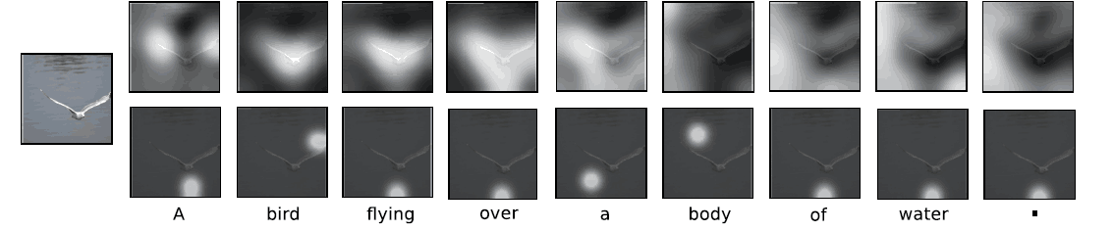
Image Caption
Soft Attention

Slide 13

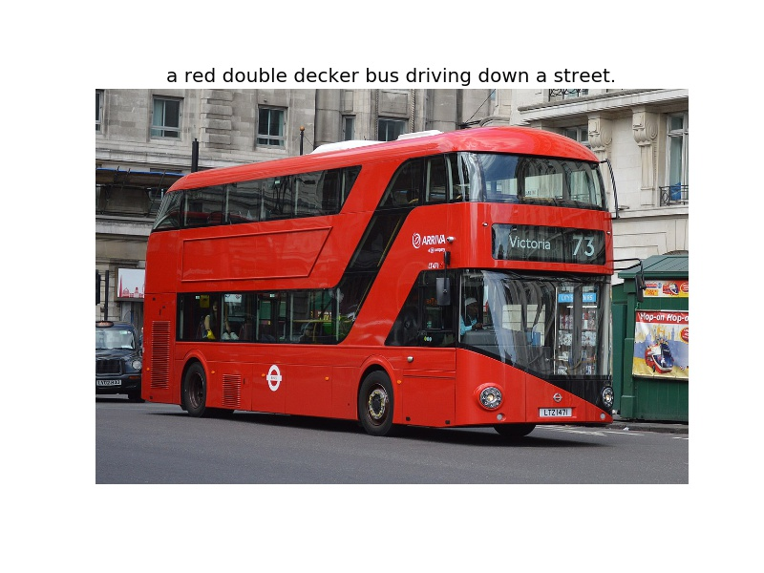
Image Caption

Slide 14
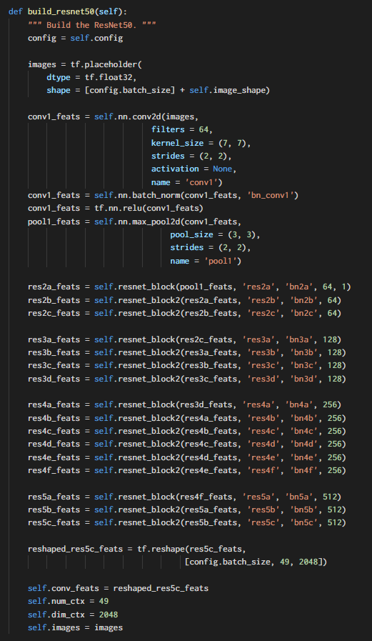
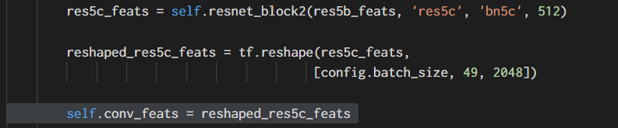
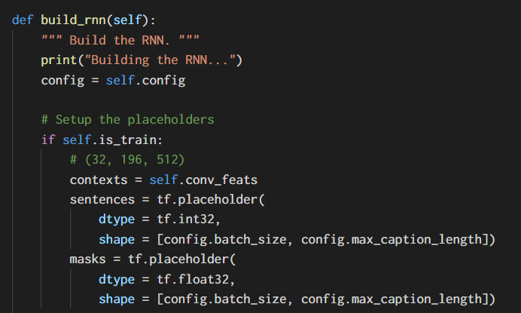
Image Caption
Coding

Slide 15
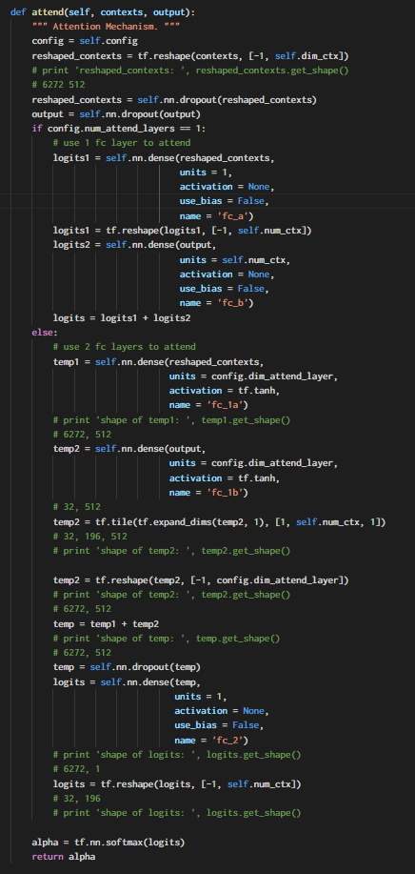
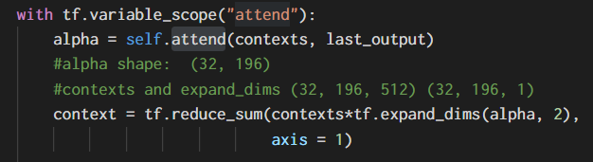
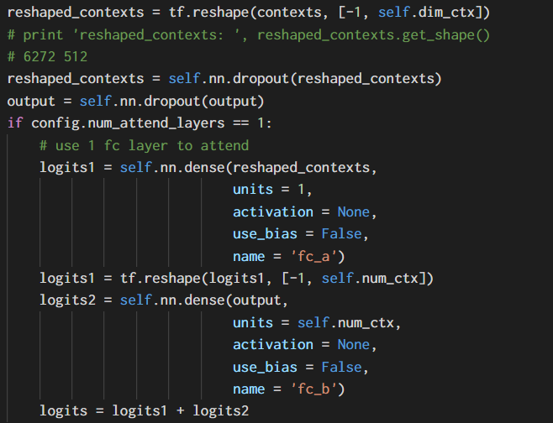
Image Caption

Slide 16
Image Caption
在医疗影像中的应用

Slide 17
Image Caption 在医疗影像中的应用
Problems
Shortage of large-scale machine-learnable medical image datasets
Lack of techniques that can mimic the high-level reasoning of human radiologists that requires years of knowledge accumulation and professional training
(3) On the other hand, radiological raw data (e.g., images, clinical annotations, and radiological reports) have been accumulated in many hospitals’ Picture Archiving and Communication Systems (PACS) for decades.
How to transform those retrospective radiological data into a machine-learnable format.

Slide 18
Image Caption 在医疗影像中的应用
Papers
Learning to Read Chest X-Rays: Recurrent Neural Cascade Model for Automated Image Annotation
2016 CVPR
National Institutes of Health
MDNet: A Semantically and Visually Interpretable Medical Image Diagnosis Network
2017 CVPR
University of Florida
TieNet: Text-Image Embedding Network for Common Thorax Disease Classification and Reporting in Chest X-rays
2018 CVPR
National Institutes of Health

Slide 19
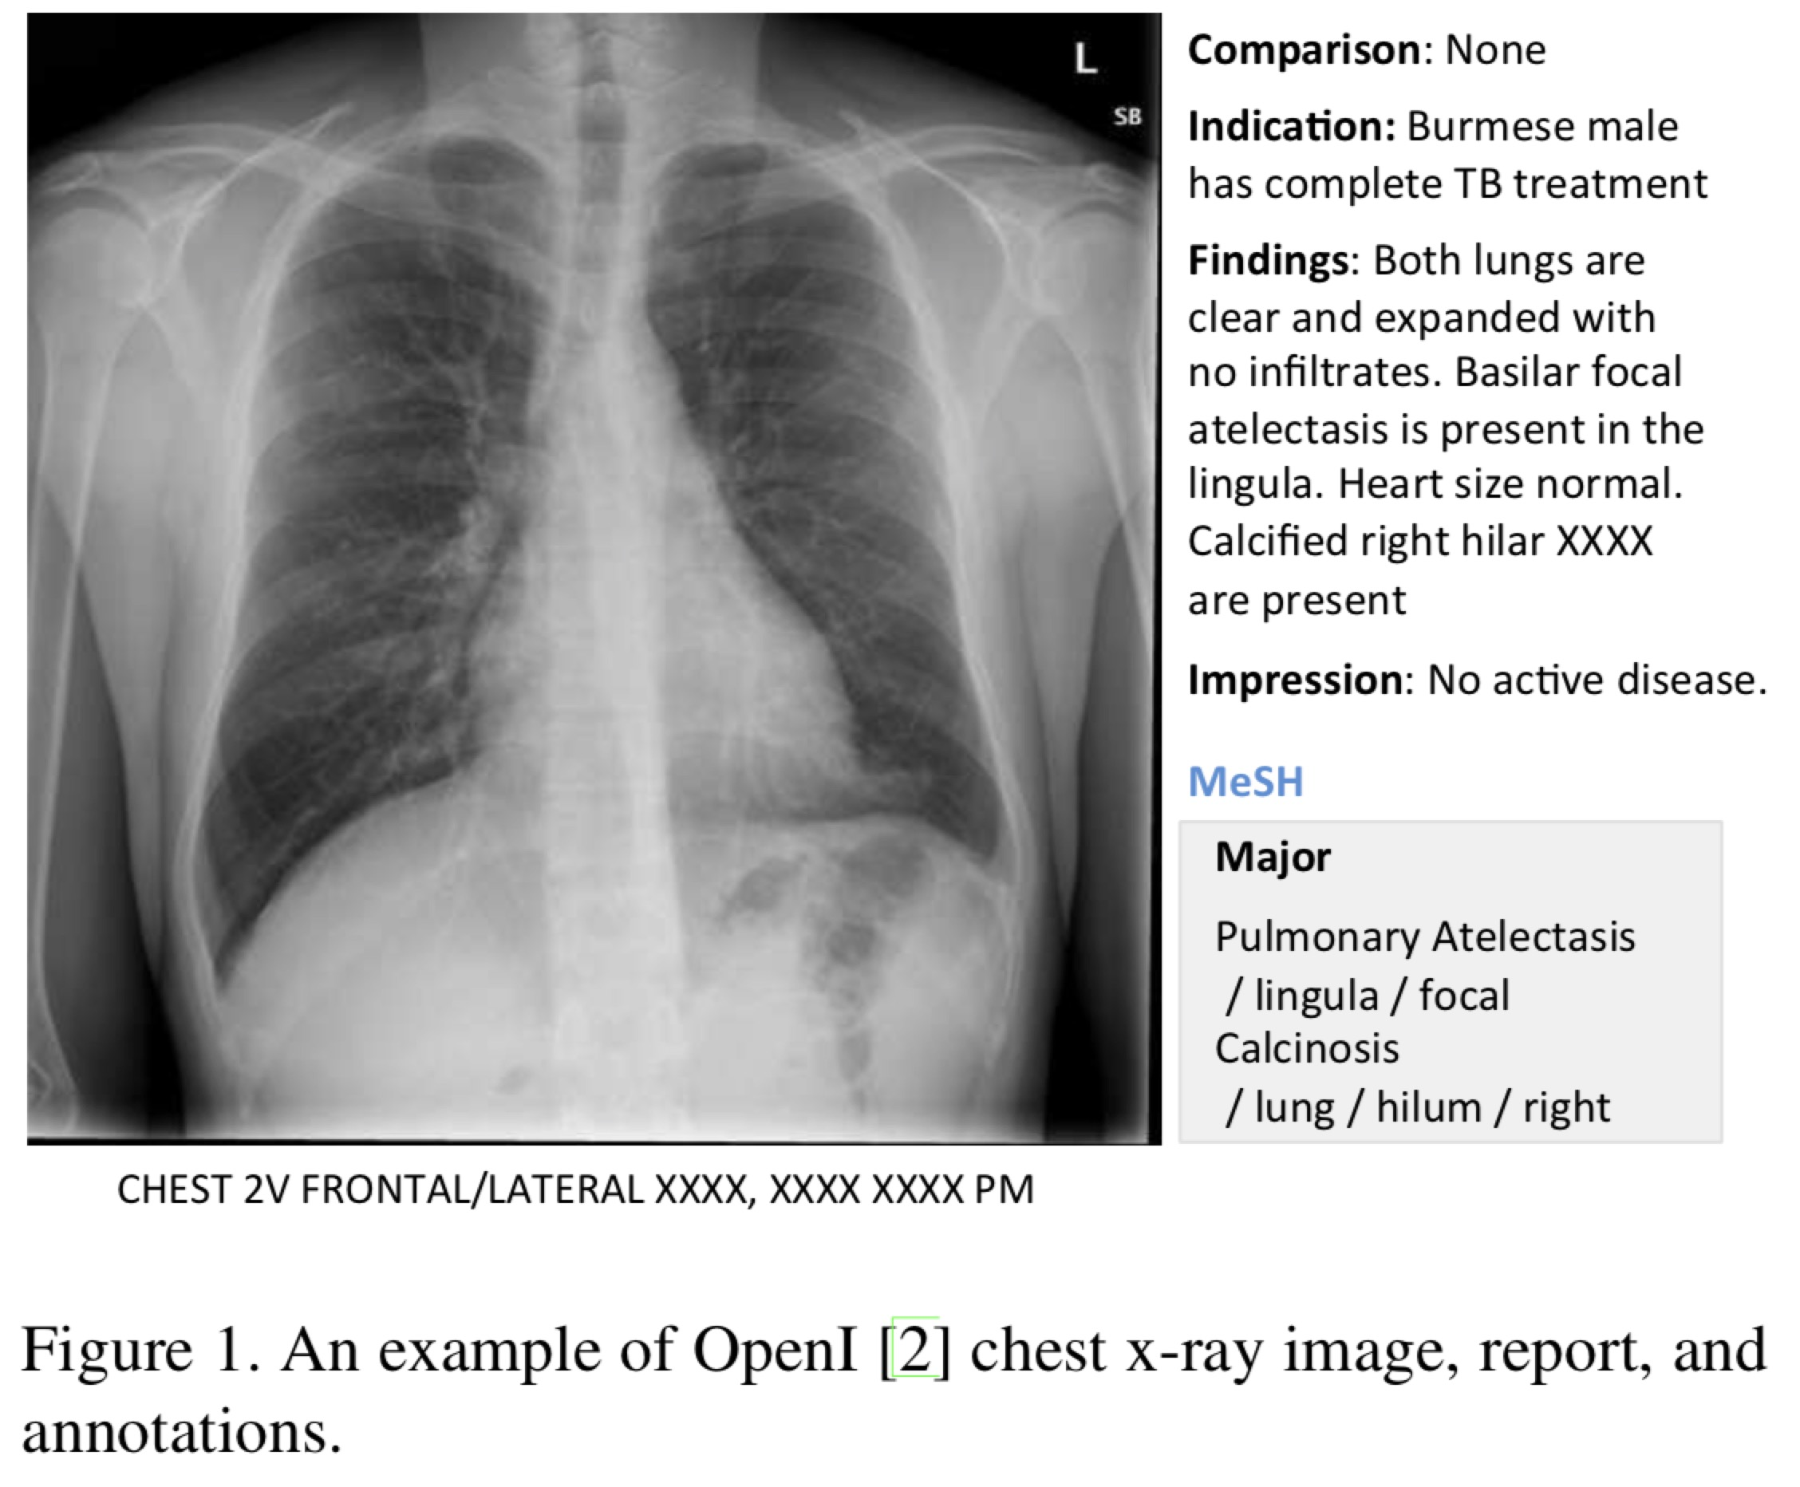
Image Caption 在医疗影像中的应用
2016 CVPR
Learning to Read Chest X-Rays: Recurrent Neural Cascade Model for Automated Image Annotation
Dataset

Slide 20
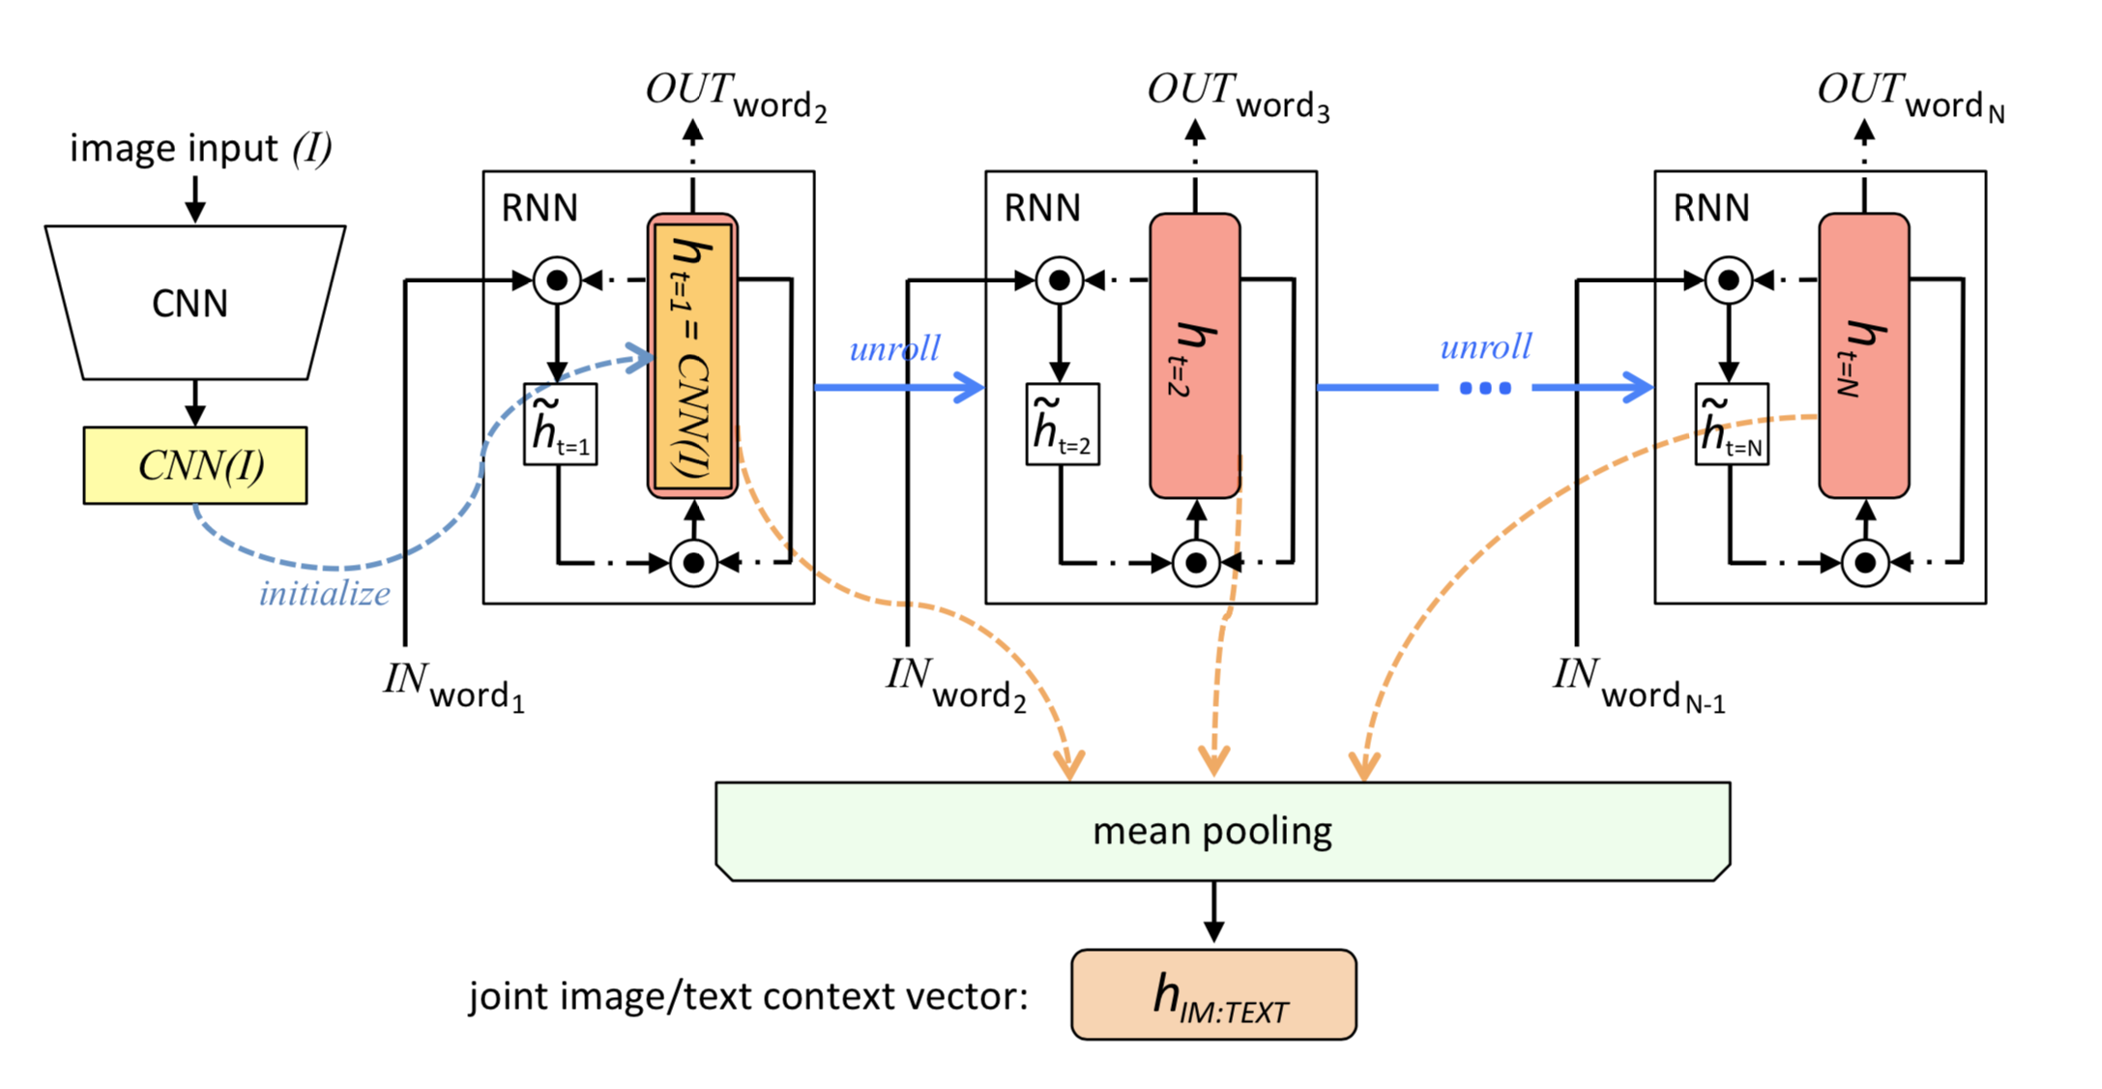
Image Caption 在医疗影像中的应用
2016 CVPR
Learning to Read Chest X-Rays: Recurrent Neural Cascade Model for Automated Image Annotation
Model
Network in Network

Slide 21
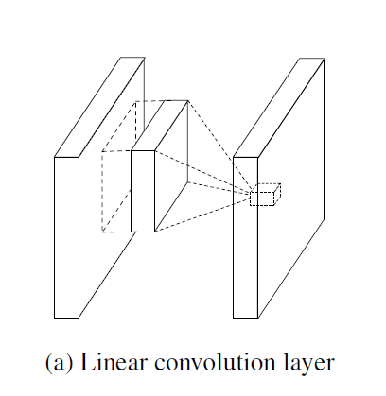
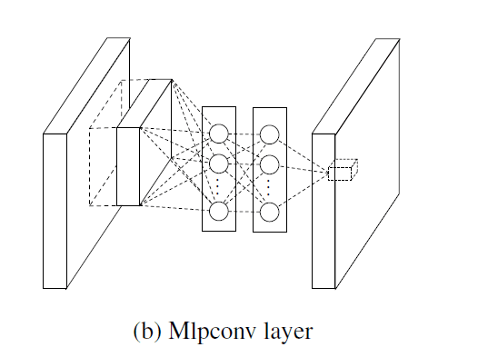
Image Caption 在医疗影像中的应用
2016 CVPR
Learning to Read Chest X-Rays: Recurrent Neural Cascade Model for Automated Image Annotation
Network in Network
Global Average Pooling
Mlpconv layer

Slide 22
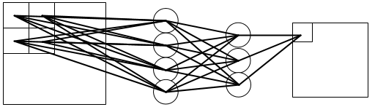
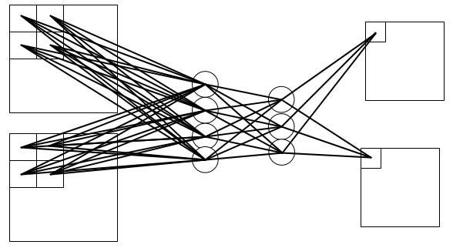
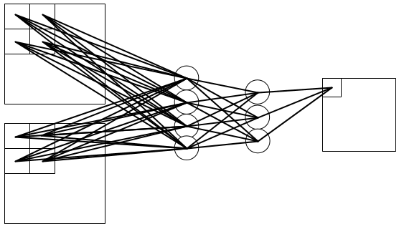
Image Caption 在医疗影像中的应用
2016 CVPR
Learning to Read Chest X-Rays: Recurrent Neural Cascade Model for Automated Image Annotation
Mlpconv

Slide 23
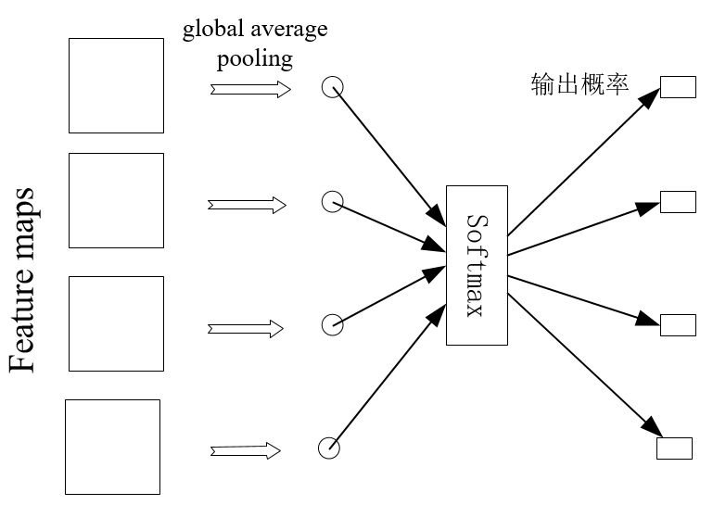
Image Caption 在医疗影像中的应用
2016 CVPR
Learning to Read Chest X-Rays: Recurrent Neural Cascade Model for Automated Image Annotation
Global Average Pooling

Slide 24
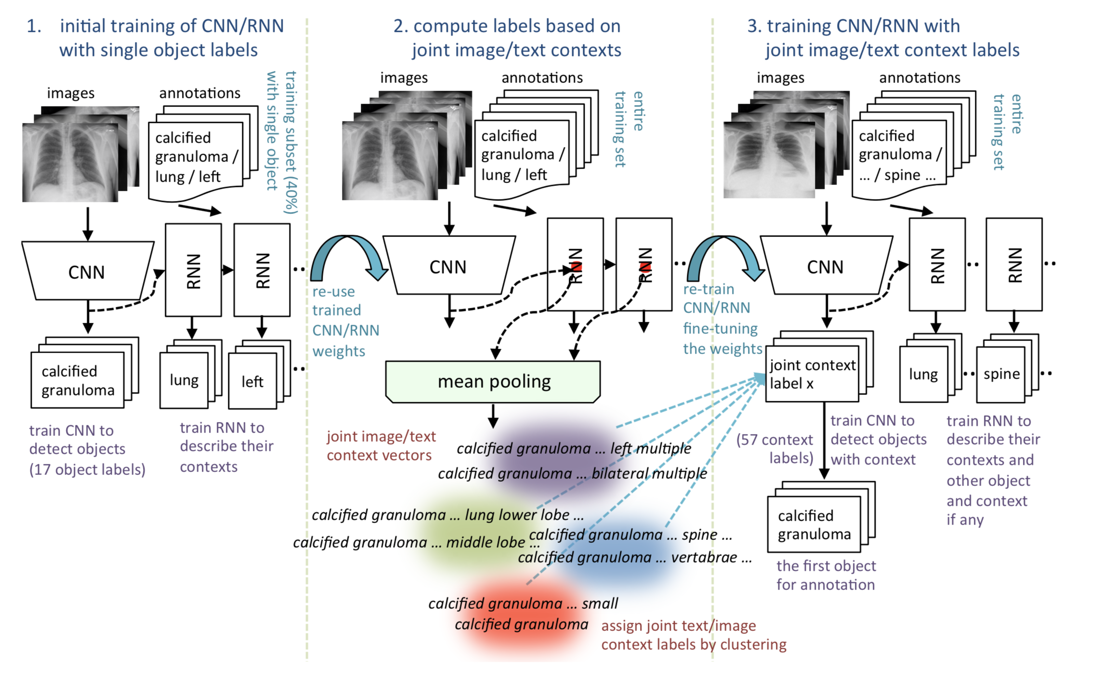
Image Caption in Medical Images

Slide 25
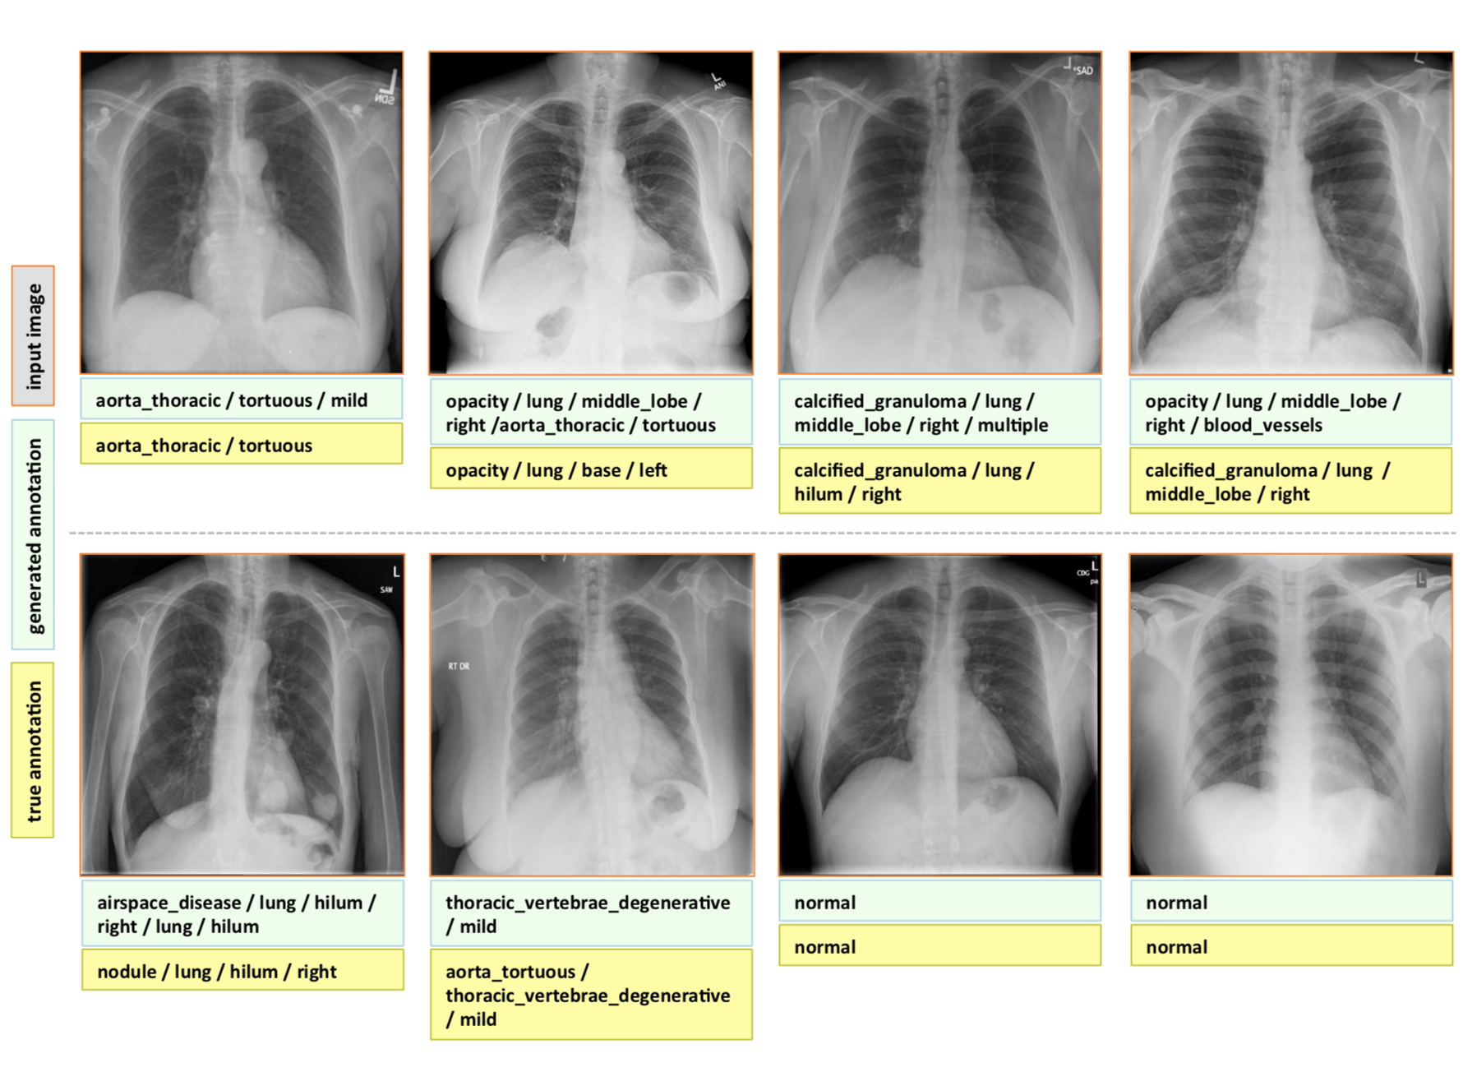

Slide 26
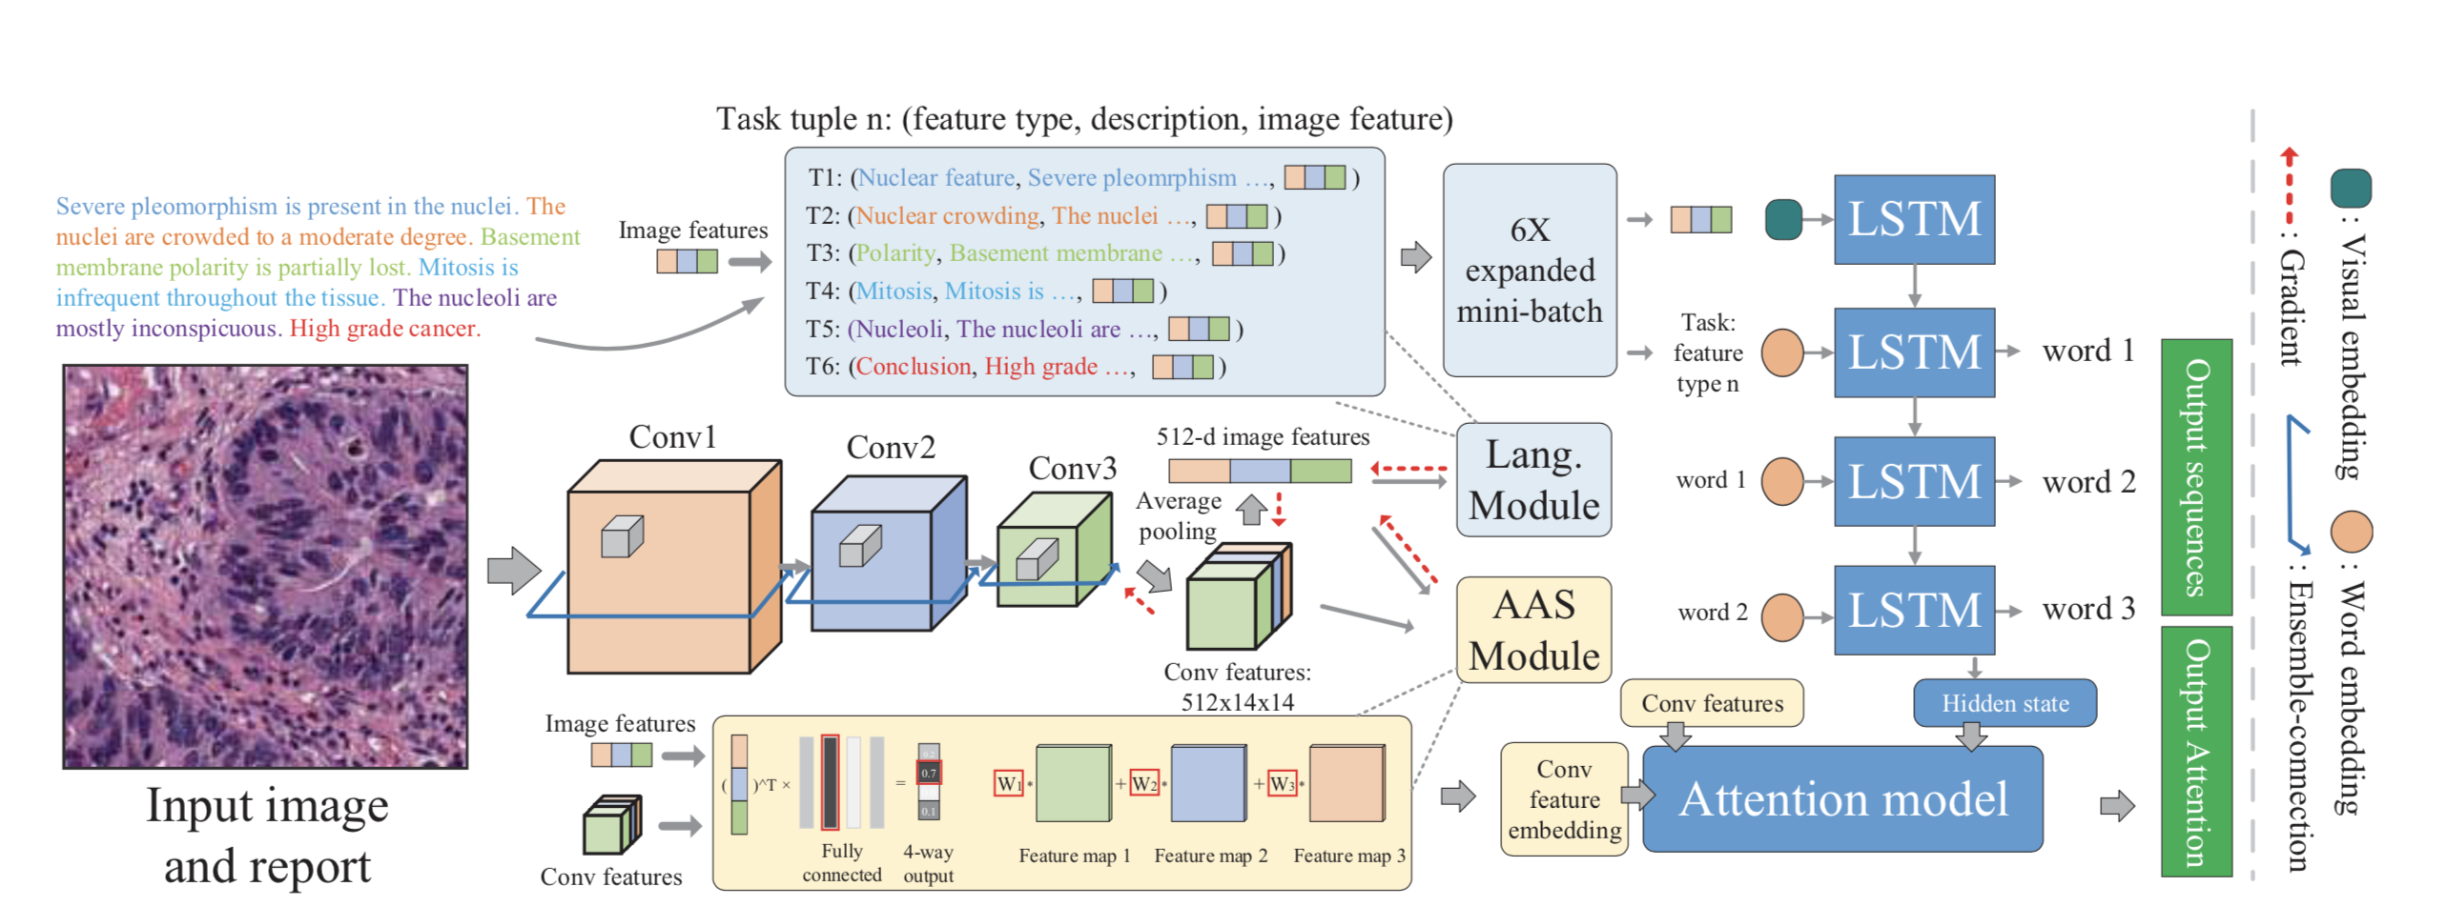
Image Caption 在医疗影像中的应用
2017 CVPR
MDNet: A Semantically and Visually Interpretable Medical Image Diagnosis Network

Slide 27
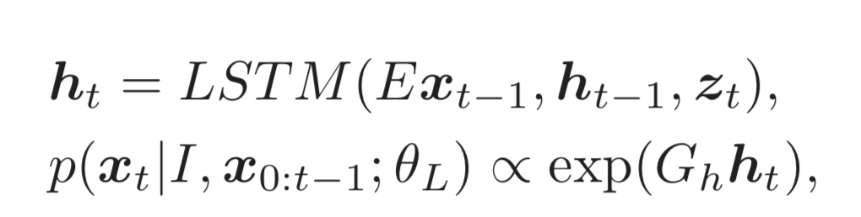
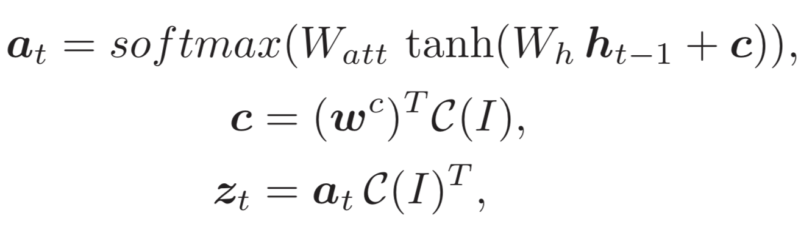
Image Caption 在医疗影像中的应用
2017 CVPR
MDNet: A Semantically and Visually Interpretable Medical Image Diagnosis Network
Auxiliary Attention Sharpening (AAS)
E is the word embedding matrix. Gh decodes ht to the output space

Slide 28
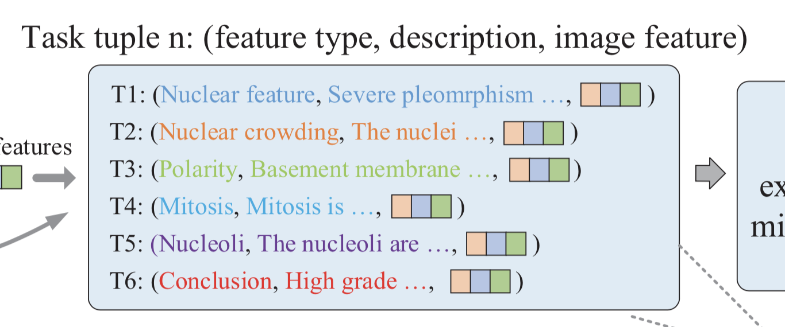
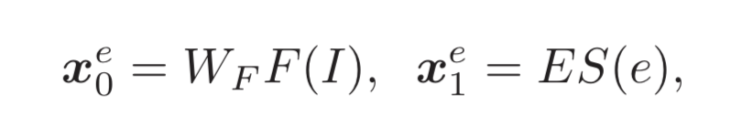
Image Caption 在医疗影像中的应用
2017 CVPR
MDNet: A Semantically and Visually Interpretable Medical Image Diagnosis Network
Auxiliary Attention Sharpening (AAS)
F(I)是由CNN提取的特征图，S(e)是第e个特征图的种类

Slide 29
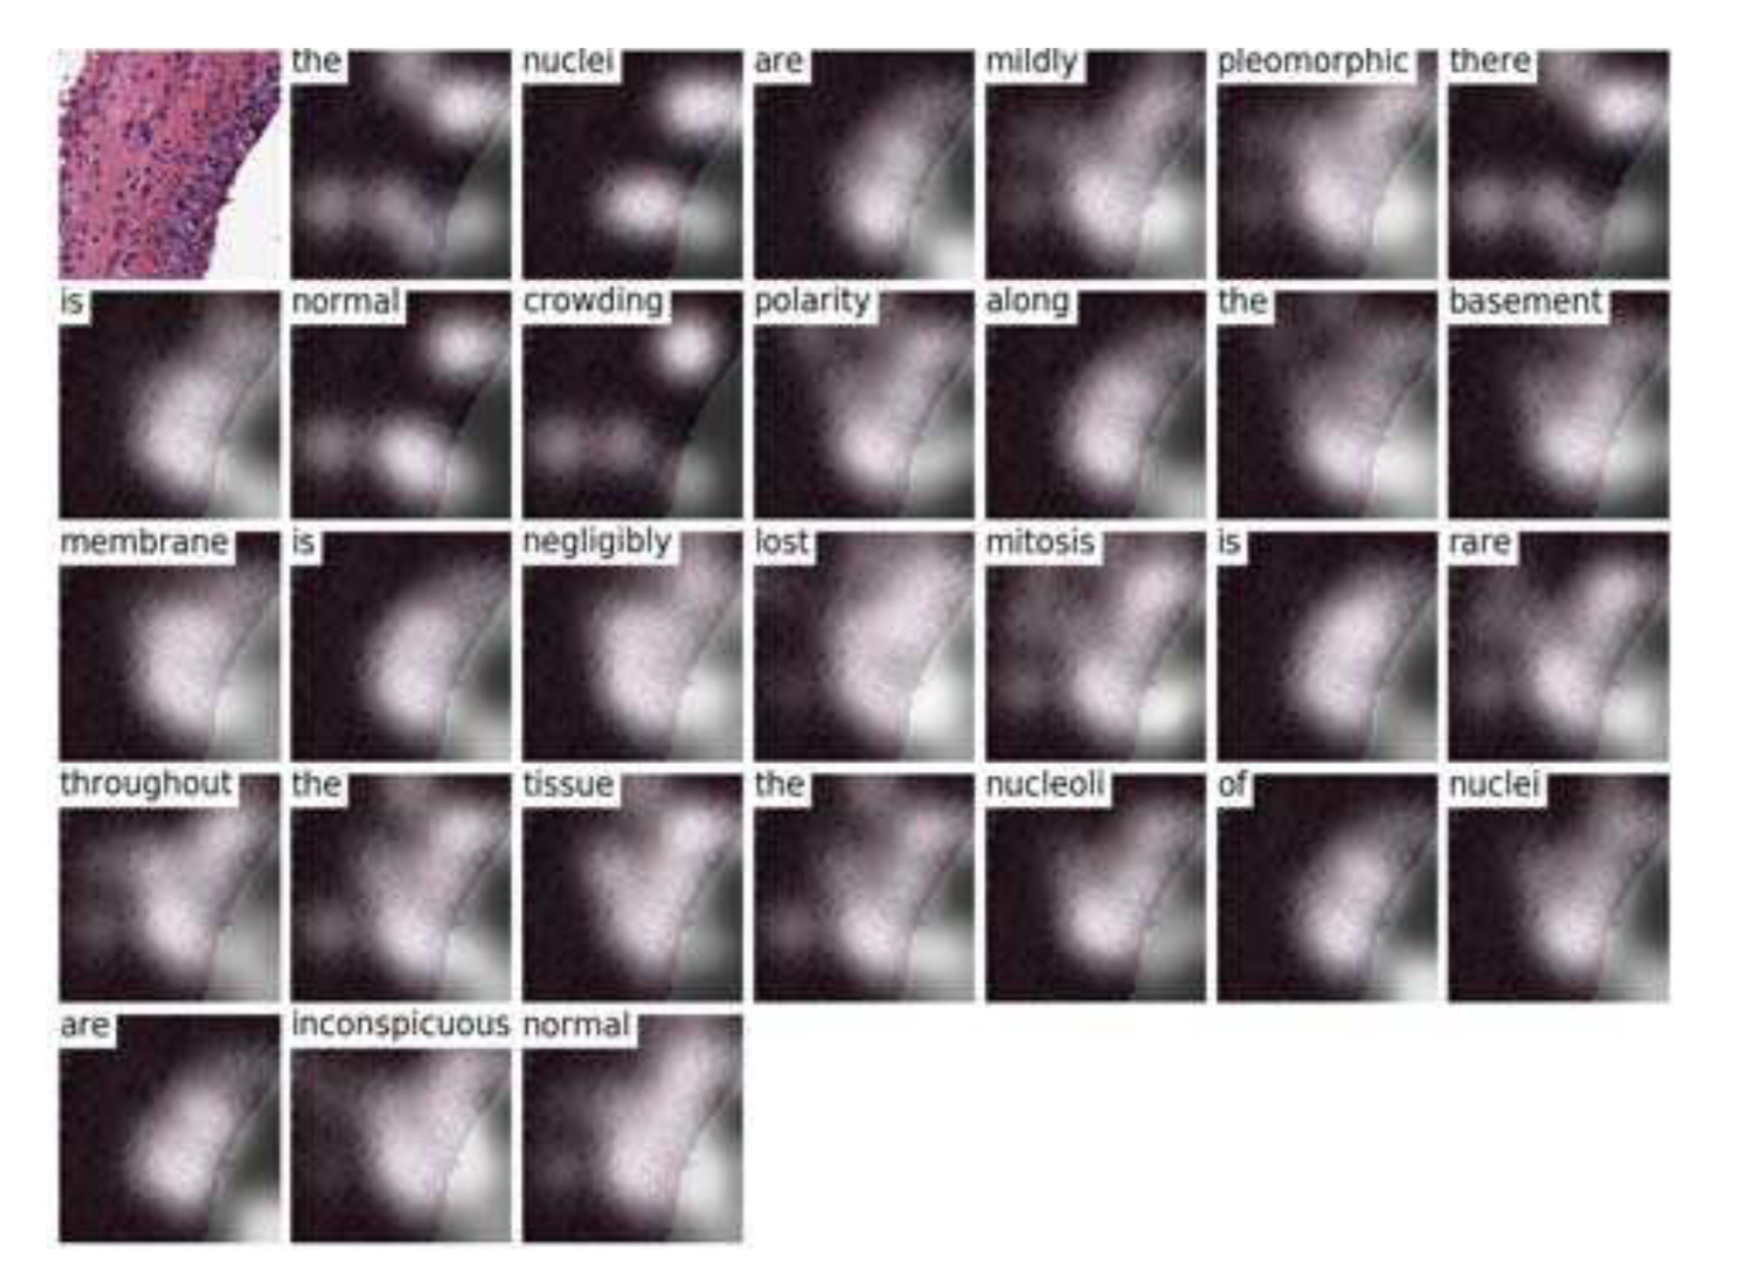
Image Caption 在医疗影像中的应用
2017 CVPR

Slide 30
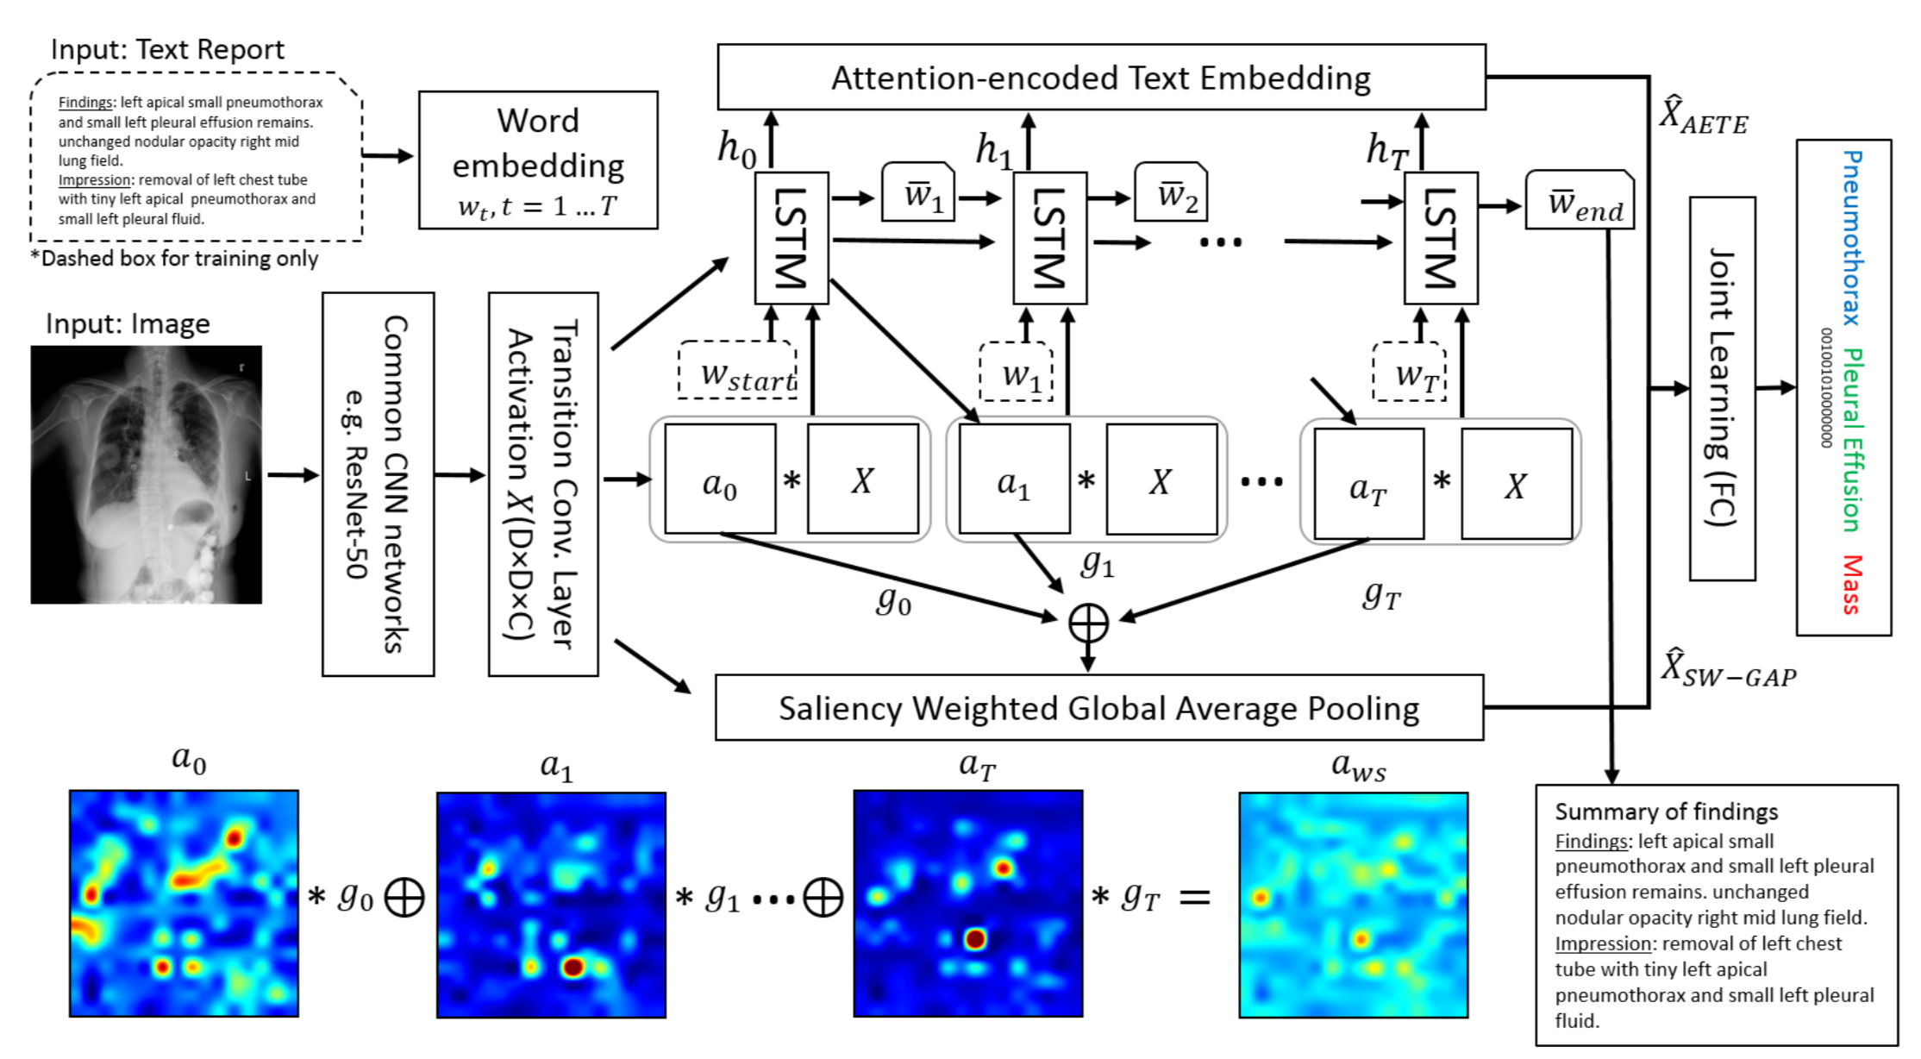
Image Caption 在医疗影像中的应用
2018 CVPR
TieNet: Text-Image Embedding Network for Common Thorax Disease Classification and Reporting in Chest X-rays

Slide 31
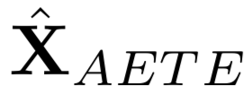
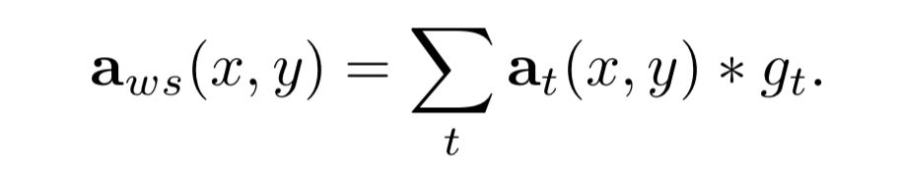
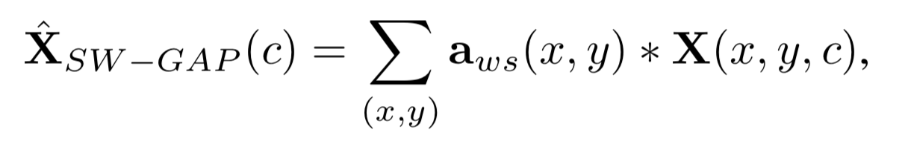
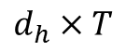
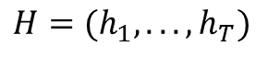
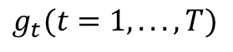

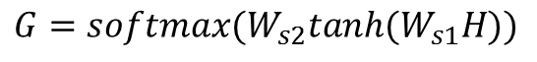
Image Caption 在医疗影像中的应用
2018 CVPR
TieNet: Text-Image Embedding Network for Common Thorax Disease Classification and Reporting in Chest X-rays
Attention Encoded Text Embedding
Let be the matrix of all hidden states.
$$H=(h_{1},...,h_{T})$$
$$d_{h}×T$$
$$G=softmax(W_{s2}tanh(W_{s1}H))$$
（r x T）
$$M=GH$$
（r x dh）
Saliency Weighted Global Average Pooling
Perform a max-over-r operation, producing a sequence of saliency values for each word wt
$$g_{t}(t=1,...,T)$$

Slide 32
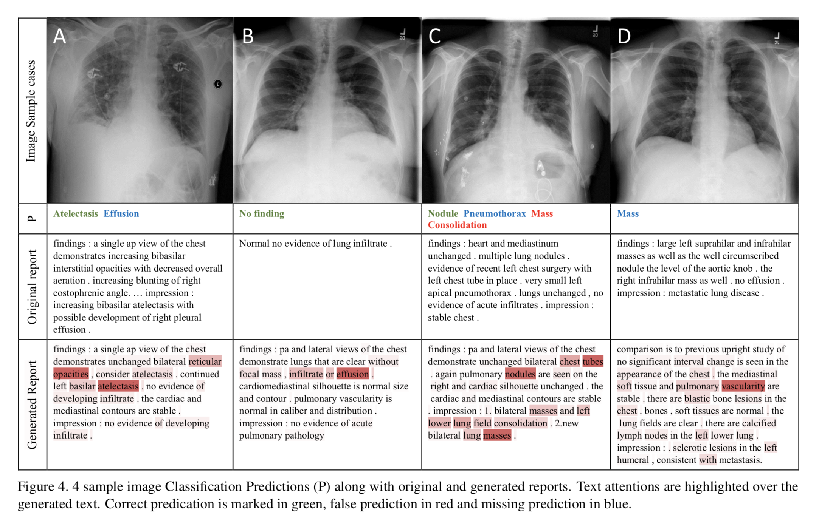
Image Caption 在医疗影像中的应用
2018 CVPR
TieNet: Text-Image Embedding Network for Common Thorax Disease Classification and Reporting in Chest X-rays

Slide 33
THANKS

